Slide 1
Chat client and server
Alex Anastassatos
Chris Skinner
Original Code Written By:
Thomas Otero

Slide 2
demo

Slide 3
What is a client and server? what are their roles?

Slide 4
Design diagram
ChatServer
Window
ChatClient
Window
ChatServer
ChatClient
ChatClient
MessageSender
ChatClient
MessageReciever
RemoteClient

Slide 5
Code initialization walk-through

Slide 6
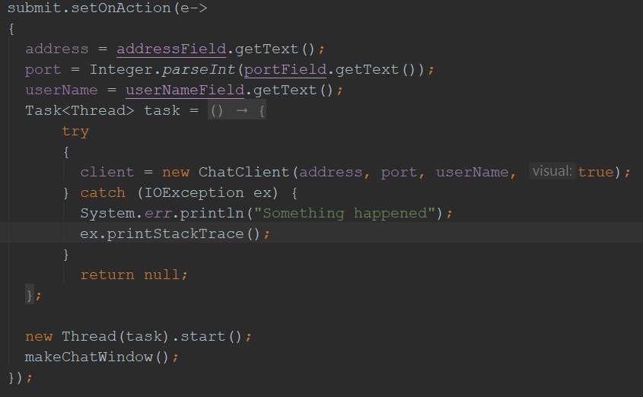
Talk about the set up of the client/server when initalized
ChatClient
Window

Slide 7
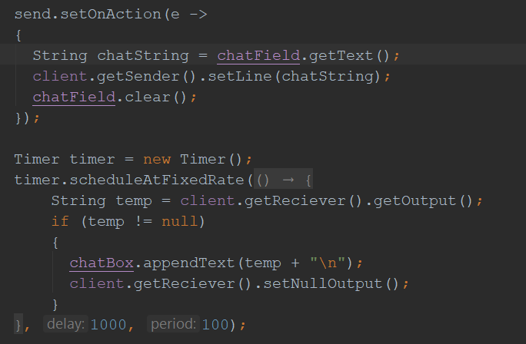
ChatClient
Window

Slide 8
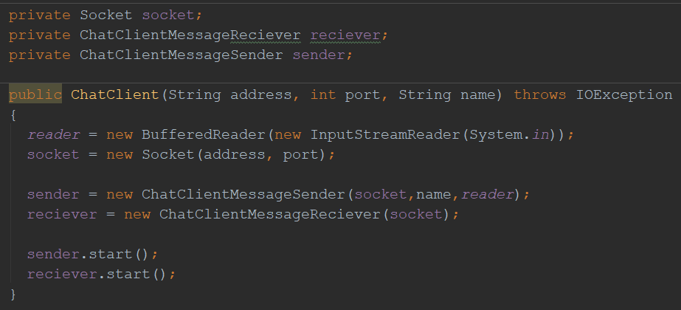
ChatClient

Slide 9
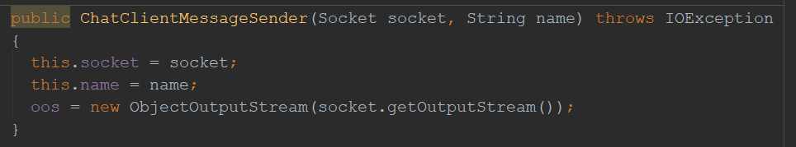
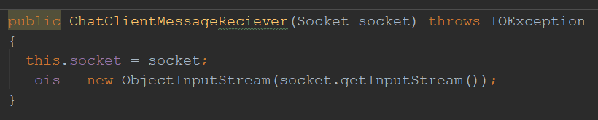
ChatClient
MessageSender
ChatClient
MessageReciever

Slide 10
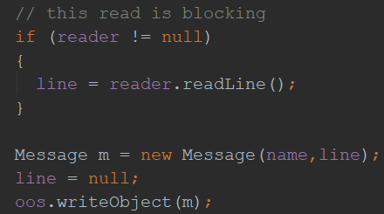
what happens when you hit send on the client?
ChatClient
MessageSender

Slide 11
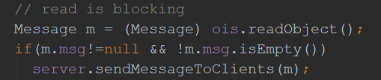
RemoteClient

Slide 12
Q & a

